Slide 1
Bio2015F HR project Data analysis meeting

Slide 2
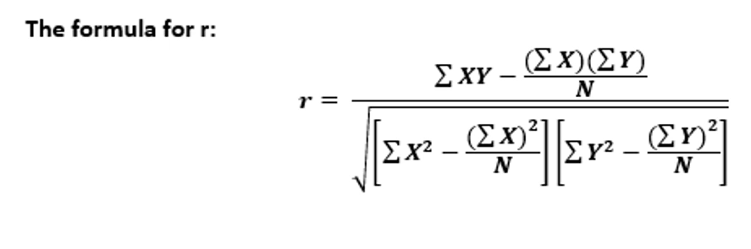
Main questions
How does daily energy expenditure (DEE) in humans scale with body mass
How to get to DEE
Convert calories burnt in kcal to KJ – keep in mind 1 kcal = 4.184 kj
Data presented in hours – how do we present that in days i.e. per day
Calculating correlation coefficient r:
x = independent variable
y = dependent variable
N = sample number

Slide 3
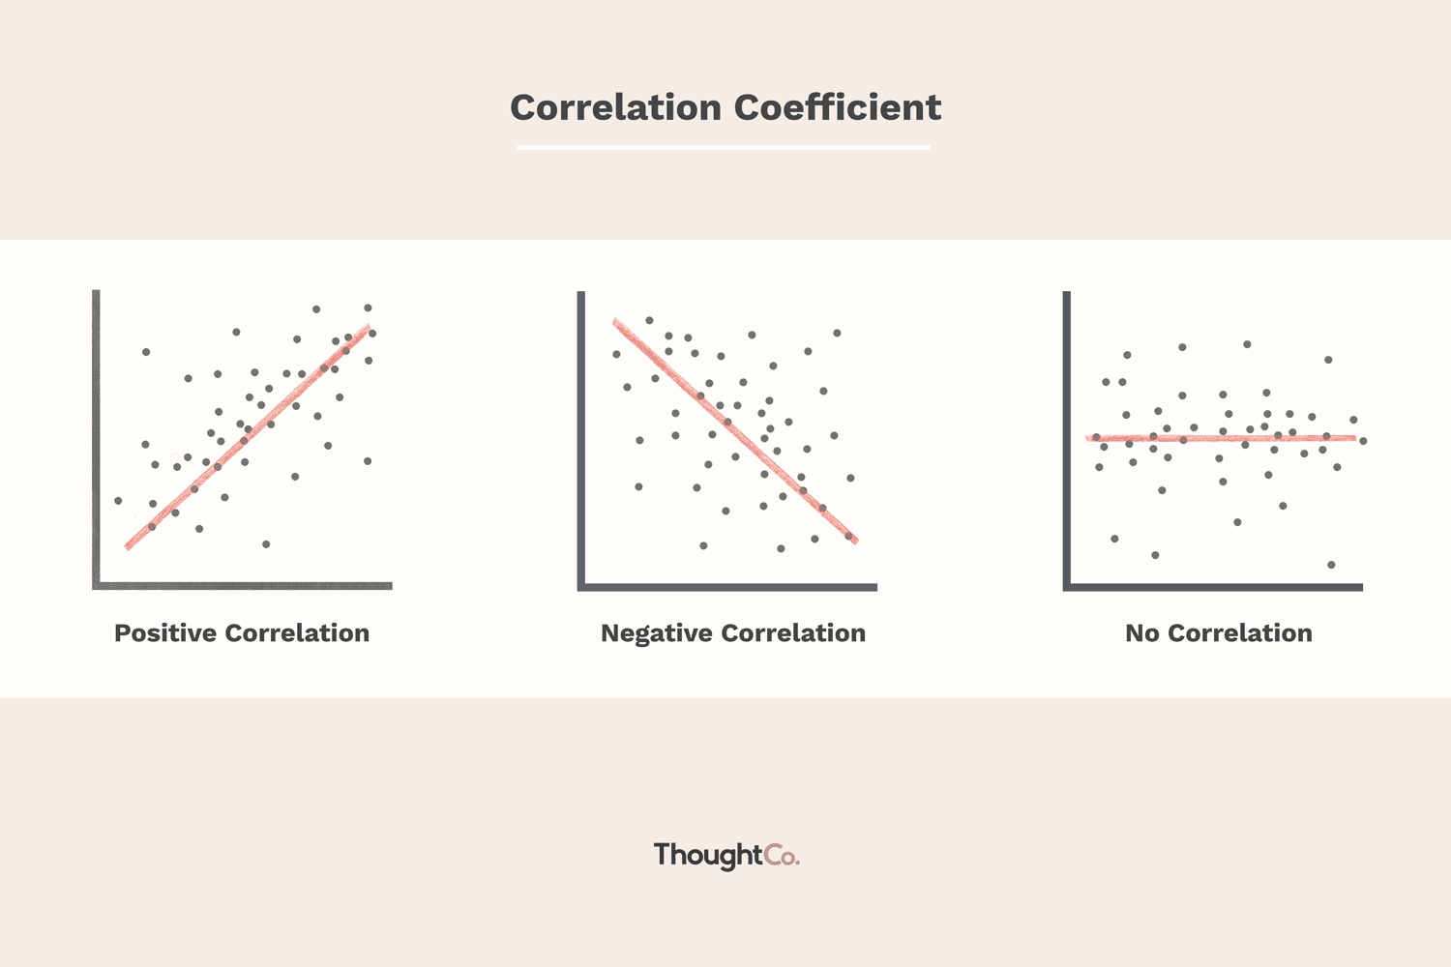
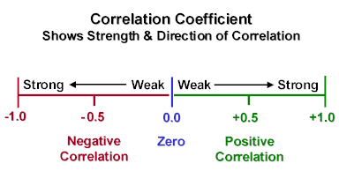
Remember rules for figures and tables:
-position of title
-axis titles
- scale

Slide 4
2. Is there a consistent difference in energy expenditure between males and females
- based on collected data
3. How does the energy expenditure of humans compare to other mammals
- in discussion
- Based on peer reviewed scientific literature

